Slide 1

SMART SYSTEM FOR WORKPLACE POSTURE MONITORING
SRM INSTITUTE OF SCIENCE AND TECHNOLOGY
SCHOOL OF COMPUTING
DEPARTMENT OF COMPUTING TECHNOLOGIES
18CSP109L - MAJOR PROJECT
Batch ID:
Student 1 Reg. No: RA2011003010415
Student 1 Name: Arnav Srivastava
Student 2 Reg. No: RA2011003010410
Student 2 Name: Ankit Singh
Guide name: Dr. M. Karthikeyan
Designation: Assistant Professor Department: C-Tech

Slide 2
Abstract
The shift from traditional in-person work to telecommuting, prompted by the pandemic, has led many employees to spend more extended periods in front of computers. Moreover, the abrupt transition to home workstations has resulted in setups that may not meet ergonomic standards for comfortable and proper positioning. From the perspective of occupational risk prevention in the medical field, there is a need for an automated tool capable of quantifying the level of incorrect posture in telecommuting employees. To address this issue, this study introduces a system focused on detecting and analyzing the posture of teleworkers. The system, implemented and tested, relies on specialized hardware employing convolutional neural networks to process real-time video. It identifies the posture of the neck, shoulders, and arms, offering recommendations to prevent potential health issues arising from poor posture. The results demonstrate that this video processing can occur in real time (up to 25 frames per second), with minimal power consumption (below 10 watts) using dedicated hardware, achieving an accuracy rate exceeding 80% in terms of posture detection.

Slide 3
Introduction
1. Prevalence of Lower Back Pain:
- Global lower back pain: 15-45%.
- Adults prone, kids less.
- Work, activity disrupted.
2. Importance of Ergonomics:
- Efficient systems crucial.
- Ergonomics boosts productivity.
3. COVID-19 Impact:
- COVID boosts screen use.
- Posture matters, avoid discomfort.
4. Role of Internet of Things (IoT):
- IoT revolutionizes healthcare.
- Rising wearables impact healthcare.

Slide 4
5. Proposed Sensor-Based Application:
- Sensor app aids health.
- Posture detection system: Analytics.
6. Unique Features of Proposed System:
- System detects posture, notifies.
- Posture history tracked.
7. Survey and Prototype Design:
- Survey gauges back pain.
- Survey shapes prototype.

Slide 5
Motivation
1. Health and Well-being:
- Telecommuter health priority.
- Posture impacts health.
2. Ergonomic Concerns:
- Home workstation challenges: ergonomics lacking.
- Address ergonomics for improvement.
3. Occupational Risk Prevention:
- Occupational risk prevention crucial.
- Automated tool crucial.
4. Innovative Solution:
- Innovative study: posture detection.
5. Specialized Hardware and Technology:
- Tech and hardware focus.
- Real-time video analysis: accurate posture detection.

Slide 6
6. Preventive Recommendations:
- Timely telecommuter health.
7. Real-time Processing and Efficiency:
- Real-time video processing: 25fps.
- Minimal power, sustainable hardware.
8. Validation through Testing:
- Study tested, credible.
9. Positive Outcomes:
- Positive outcomes emphasized: 80% accuracy.
10. Overall Impact:
- System promotes health.

Slide 7
Literature Review
1. Prevalence of Incorrect Posture:
- Poor posture harms.
- Poor posture risks.
2. Integration of Cameras in Smart Systems:
- Cameras monitor posture.
- Non-intrusive, accurate approach.
3. Technological Advancements in Computer Vision:
- Computer vision, CNN fusion.
- Real-time video processing.
4. Holistic Understanding of Workplace Ergonomics:
- Holistic ergonomics with cameras.
- Posture systems proactive.
5. Organizational Emphasis on Employee Well-being:
- Posture monitoring gains traction.
- Tech fosters health-aligned habits.

Slide 8
Literature Review
6. Role of Specialized Hardware:
- Hardware crucial for processing.
- Balancing accuracy, sustainability.
7. Validation through Rigorous Testing:
- Tech needs real-world testing.
- Validation crucial for systems.
8. User Acceptance and Integration:
- User acceptance crucial.
- User embrace vital.
9. Contributions to Occupational Health:
- "Smart System" aids health.
- Tech anticipates advancements.
10. Balancing Technological Prowess and Practicality:
- Studies stress balanced approach.
- Balance drives health innovation.

Slide 9
Literature Review
11. Dual-Functionality of Posture Monitoring Systems:
- Specialized hardware, seamless operation.
- Efficient, accurate, sustainable.
12. Comprehensive Approach to Workplace Ergonomics:
- Advance insights, action-focused.
- Modern workplaces prioritize well-being.
13. Future Research Considerations:
- Review reveals research gaps.
- Roadmap for smart system.
14. Envisioning Advancements through Camera-Based Technologies:
- Review spurs tech integration.
- Posture tech evolves.

Slide 10
Challenges and Limitations
1. Ergonomic Setup Variability:
- Telecommuters' diverse setups challenge.
2. Limited Physical Interaction:
- Telecommuters' diverse setups challenge.
3. User Compliance and Engagement:
- System lacks posture correction.
4. Privacy Concerns:
- Video monitoring privacy concerns.
5. System Calibration for Diverse Users:
- Custom calibration vital.
6. Hardware Accessibility and Cost:
- Hardware limits adoption.

Slide 11
Challenges and Limitations
7. Technical Expertise Requirement:
- Tech setup expertise needed.
8. Potential for False Positives/Negatives:
- Accuracy exceeds 80%.
9. Adaptability to Dynamic Work Environments:
- Dynamic work poses challenges.
10. Network and Connectivity Issues:
- Stable network crucial.
11. Long-term Health Impact Assessment:
- Study lacks long-term data.

Slide 12
Objectives of the project
1. Develop an Automated Posture Detection System:
- Automated posture analysis system.
2. Address Ergonomic Challenges in Telecommuting:
- Home ergonomics support.
3. Quantify Incorrect Posture Levels:
- Quantify posture, prevent issues.
4. Utilize Convolutional Neural Networks (CNNs):
- Hardware IDs posture efficiently.
5. Offer Recommendations for Posture Improvement:
- Prevent health issues.
6. Ensure Real-Time Video Processing:
- Real-time video processing: 25fps.

Slide 13
Objectives of the project
7. Minimize Power Consumption:
- Design for low consumption.
8. Achieve High Accuracy in Posture Detection:
- Test for 85% accuracy.
9. Contribute to Occupational Risk Prevention:
- Telecommute health tool.
10. Evaluate Long-Term Health Impact:
- Long-term assessment essential.

Slide 14
Innovation idea of the project
1. Introduce Augmented Reality (AR) Integration:
- AR enhances posture feedback.
2. Implement AI-driven Adaptive Recommendations:
- AI tailors posture plans.
3. Integrate Wearable Devices for Holistic Monitoring:
- Integrate wearables for insight.
4. Gamify Posture Improvement:
- Gamify posture, incentivize participation.
5. Incorporate Voice Recognition for Hands-Free Interaction:
- Voice recognition enhances UX.
6. Enable Virtual Collaboration Spaces:
- Virtual spaces aid communication.

Slide 15
Innovation idea of the project
7. Implement Stress Level Monitoring:
- Monitor stress through posture.
8. Explore Biofeedback Mechanisms:
- Biofeedback enhances immersion.
9. Enhance Accessibility with Mobile Applications:
- User-friendly app enhances posture.
10. Implement Continuous Learning Algorithms:
- Adapt, learn, integrate.

Slide 16
Scope and Application
1. Telecommuting Workforce Wellness:
- Scope: Telecommuter well-being improved.
- Application: Home workers, posture feedback.
2. Occupational Risk Prevention:
- Scope: Project enhances medical safety.
- Application: Prevents health issues proactively.
3. Automated Posture Detection and Analysis:
- Scope: Automated posture detection.
- Application: Hands-free posture monitoring.
4. Specialized Hardware and Convolutional Neural Networks (CNNs):
- Scope: Specialized hardware, efficient CNNs.
- Application: Versatile system, high speed.

Slide 17
Scope and Application
5. Real-time Video Processing:
- Scope: Real-time posture feedback.
- Application: Telecommuters adjust timely.
6. Low Power Consumption:
- Scope: Low consumption, sustainable usage.
- Application: Continuous use, low impact.
7. Accuracy in Posture Detection:
- Scope: 80% accuracy reliable.
- Application: Reliable system, healthy posture.
8. Potential for Remote Health Monitoring:
- Scope: Posture data aids wellness.
- Application: System tracks health metrics.

Slide 18
Scope and Application
9. Integration with Existing Work Environments:
- Scope: Seamless integration, diverse workstations.
- Application: Remote work adapts effectively.
10. User-friendly Implementation:
- Scope: User-friendly posture apps.
- Application: Convenient interaction promotes adoption.

Slide 19
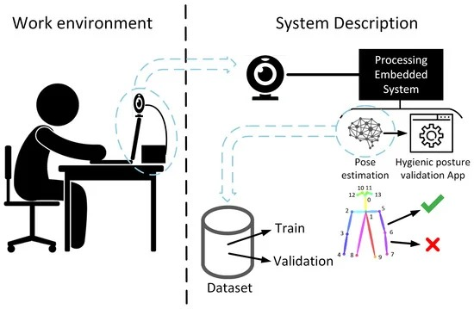
Architecture

Slide 20
Proposed Modules
1. Data Acquisition Module:
- Collects real-time posture data.
2. Specialized Hardware Integration:
- Hardware manages posture seamlessly.
3. Convolutional Neural Network (CNN) Implementation:
- CNN algorithm detects postures.
4. Real-time Video Processing Module:
- Fast video feedback: 25fps.
5. Posture Analysis and Classification:
- Analyze video for posture.
6. User Feedback and Recommendations:
- Personalized posture advice prevents issues.

Slide 21
Proposed Modules
7. Power Management Module:
- Optimizes power for efficiency.
8. User Interface Development:
- User-friendly interface designs: desktop app.
9. Continuous Learning Algorithm:
- Continuous learning algorithm enhances personalization.
10. Privacy and Security Module:
- Privacy, security ensured.
11. Remote Monitoring and Analytics:
- Remote monitoring aids intervention.
12. Long-Term Impact Assessment Module:
- Assess long-term impact.

Slide 22
Algorithm Description
1. Data Acquisition:
- Video data: neck, shoulders.
2. Preprocessing:
- Enhance video quality: preprocessing.
3. Frame Segmentation:
- Stream split, analyze frames.
4. Specialized Hardware Initialization:
- Hardware sync, initialize.
5. Convolutional Neural Network (CNN) Loading:
- Load posture detection model.
6. Real-time Video Processing:
- Real-time posture feedback: 25fps.

Slide 23
Algorithm Description
7. Posture Identification:
- CNN classifies posture.
8. Accuracy Assessment:
- Evaluate the accuracy of posture detection by comparing the CNN predictions with ground truth data from labeled frames in the training dataset.
9. Recommendation Generation:
- Customized posture advice.
10. Power Consumption Monitoring:
- Monitor for efficiency.
11. User Interface Update:
- Interface update: real-time feedback.
12. Continuous Learning Mechanism:
- Algorithms adapt, improve posture.

Slide 24
Algorithm Description
13. Privacy Measures:
- Encrypt data, protect privacy.
14. Remote Monitoring Integration:
- Remote monitoring enables intervention.
15. Long-Term Impact Assessment:
- Algorithm assesses health trends.

Slide 25
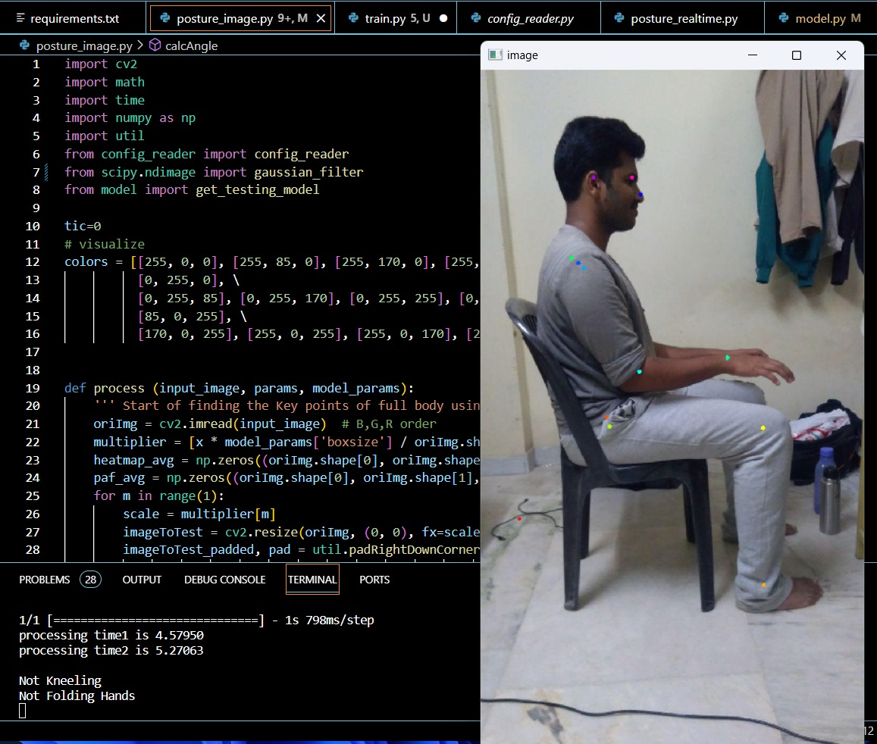
OUTPUT

Slide 26
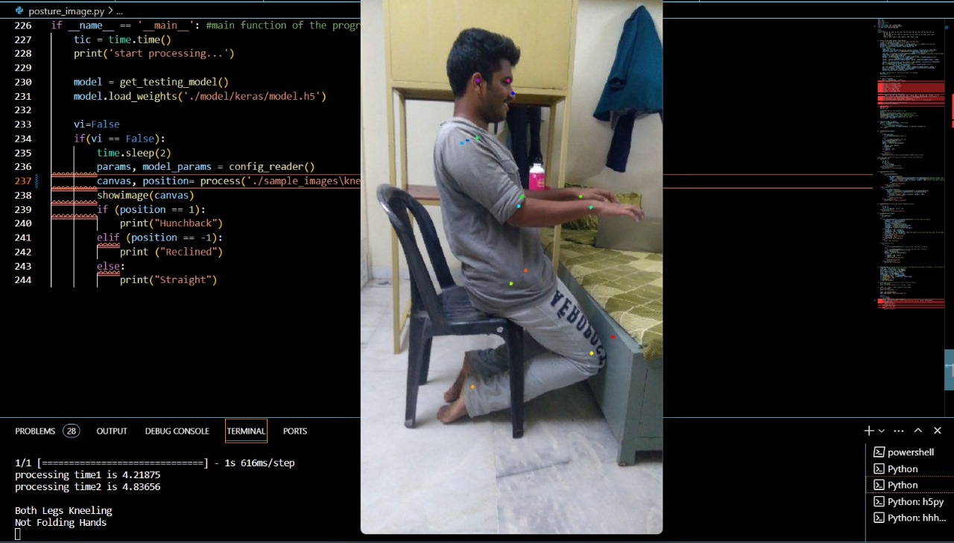
OUTPUT

Slide 27
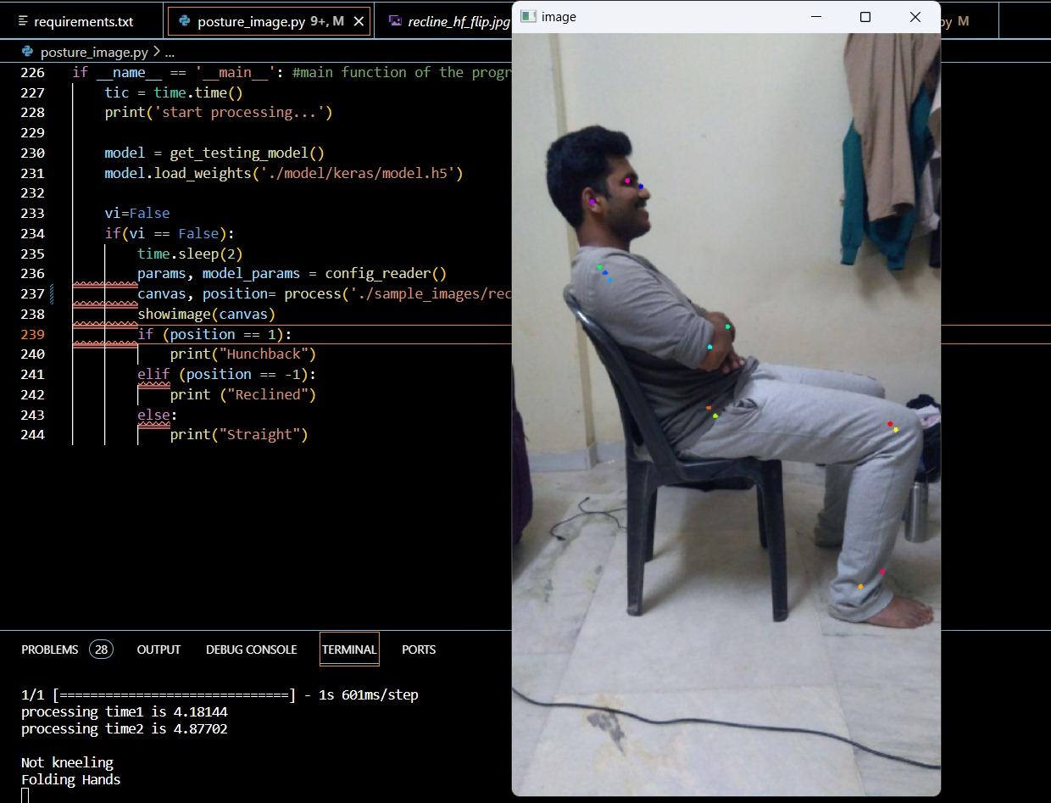
OUTPUT

